Slide 1
Choosing The Best Method for New Office Stationery Sales
Jungseok Lee
Notes:
Hello, My name is Jungseok.
I'm gonna start my Data Analyst Practical Exam Presentation about Newly launched office stationery sales.

Slide 2
Business Goals
The sales team at Pens and Printers wants to ensure they are using the best sales method to sell the new product effectively.
They have tested three different methods: 'Email’, 'Call’, and 'Email + Call’(a combined method of the two).
The sales team want to know the following insights:
The number of customers for each sales method
The distribution of overall revenue and revenue for each sales method
The difference in revenue over time for each sales method
Other differences between the customers in each group
Recommendation for the best sales method
Notes:
The sales team wanna use the best sales method to sell the new product *effectively.
There are three different methods, such as Email, Call, and a combined method of the two called Email+Call.
The team also wanna get a final recommendation for the best sales method and some supporting information like the number of customers and the distribution of revenue for each method.
To provide these insights, I will explain them in sequence.

Slide 3
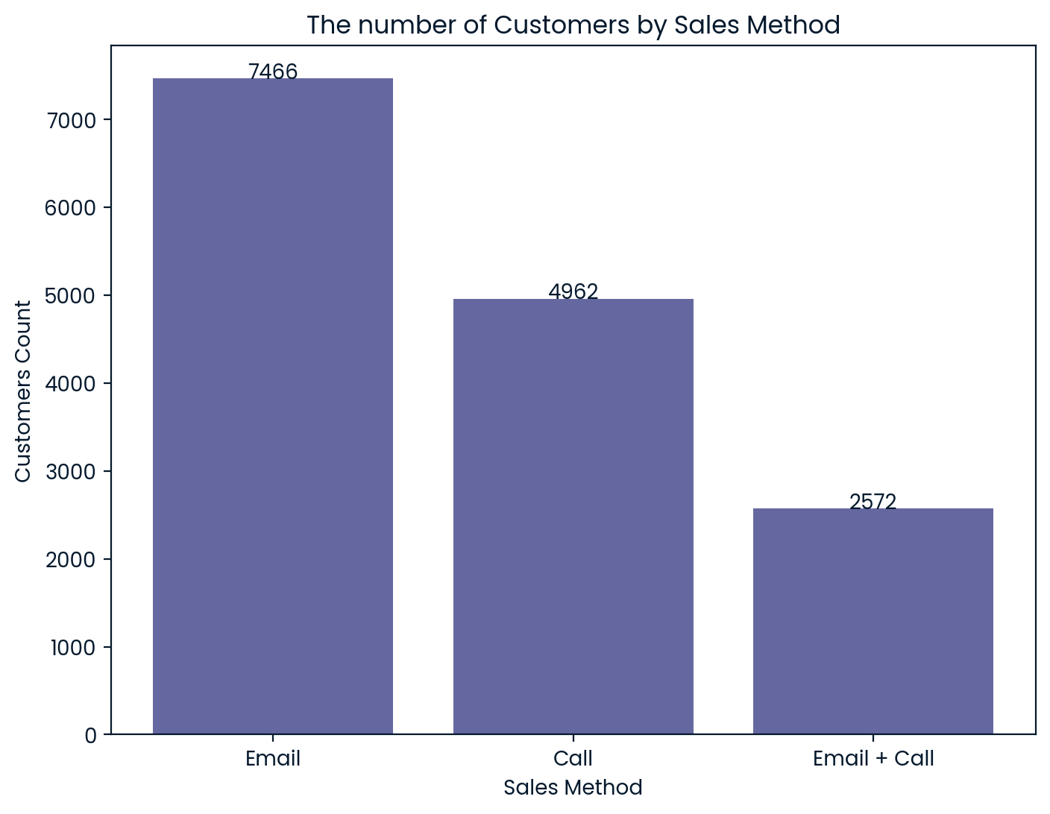
Outcomes
The number of customers for each sales method
According to the bar chart, Email is the most commonly used method, followed by Call, and the least common method is Email + Call.
The total number of customers is 15,000.
Email accounts for about 50%, followed by Call’s 33%, while the proportion of the combined method Email + Call is only about 17%
Notes:
First, let's start with the number of customers chart for each method.
Based on the bar chart, Email is the most commonly used method, followed by Call and Email+Call.
Among the total of 15,000 customers, Email accounts for 50%, followed by Call, while the proportion of the combined method Email+Call is only 17%

Slide 4
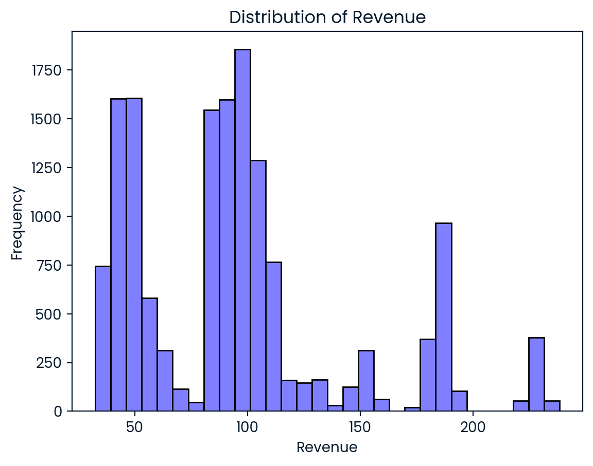
Outcomes
The distribution of overall revenue
According to the histogram, revenue is primarily concentrated around 50 and 100, with a moderate distribution around 180.
Notes:
Next, if we look at the overall revenue distribution, we can see that there are two high peaks around 50, 100, and one moderate peak around 180.
Please remember this distribution and compare it to the multiple boxplots on the next slide.

Slide 5
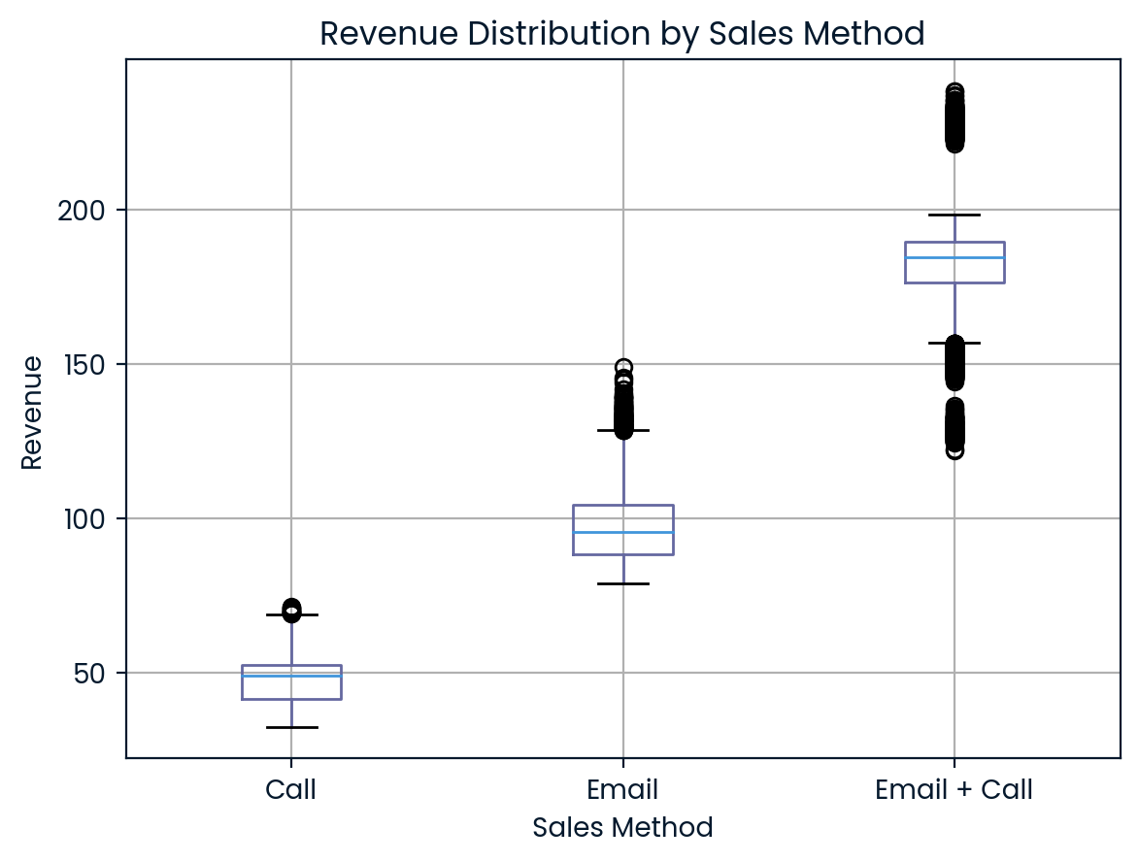
Outcomes
The distribution of revenue for each sales method
The median for Call is approximately 50, for Email it is around 90, and for Email + Call, it is about 180.
Three median values correspond to the three peaks shown on the previous slide.
In summary, the revenue distribution is clearly differentiated by sales method
Notes:
These boxplots show the revenue distribution for each sales method.
The median for Call is 50, for Email it is 90, and for Email + Call, it is 180.
We can see that the three median values ​​correspond to the three peaks shown on the previous slide.
In summary, the revenue distribution is clearly differentiated by sales method.

Slide 6
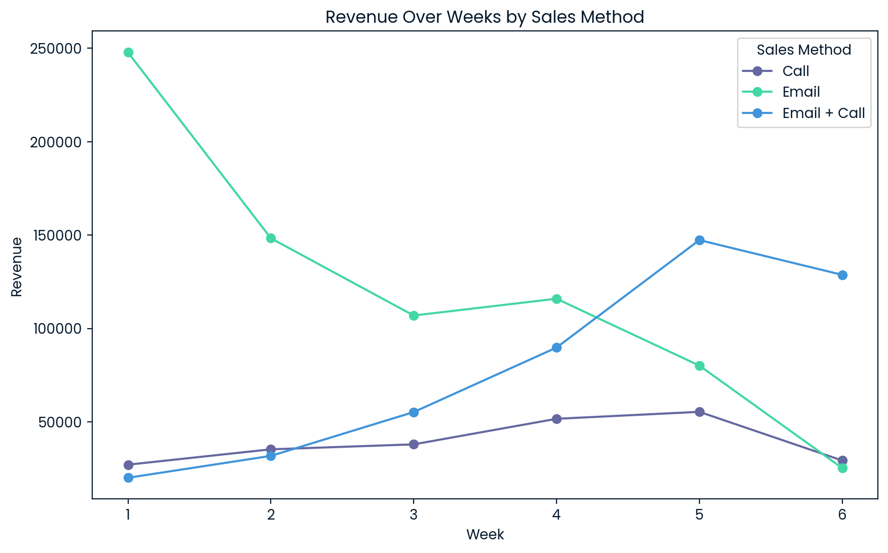
Outcomes
The difference in revenue over time for each sales method
Email line initially shows significantly high revenue but exhibits a decreasing trend over time.
Call line shows its revenue increasing slowly but remaining low overall.
In contrast, Email + Call line starts with the lowest revenue initially, but demonstrates a substantial increasing trend up to week 5, followed by a slight decrease in week 6, but it still remains at a moderatly high value.
Notes:
Now let's look at the sales trends for each method.
Email generates substantial revenue initially but declines (significantly) over time.
Call increases slowly but remains low overall.
In contrast, Email+Call starts with the lowest revenue, but substantially increases up to week 5, followed by a slight decrease in week 6, but it still remains at a moderatly high level.

Slide 7
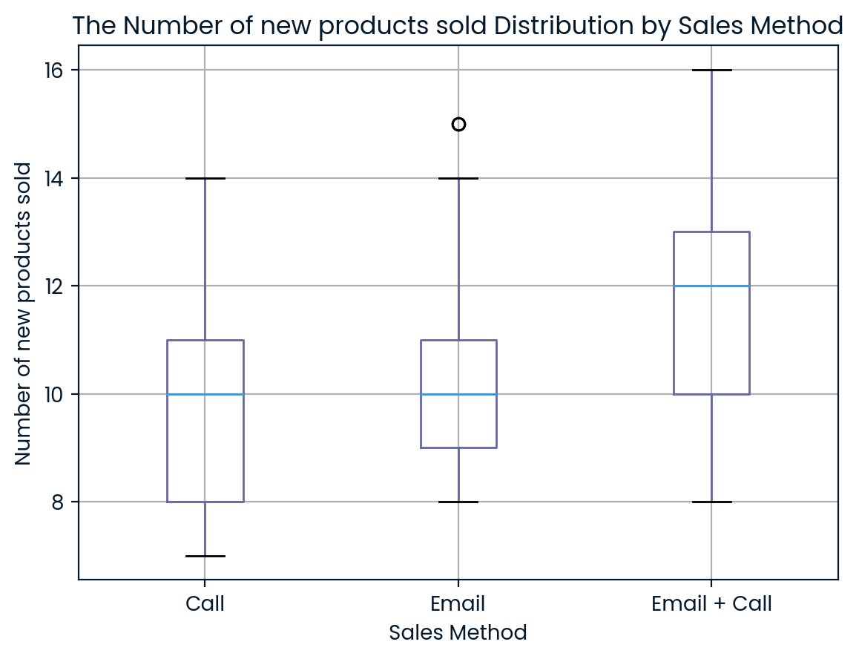
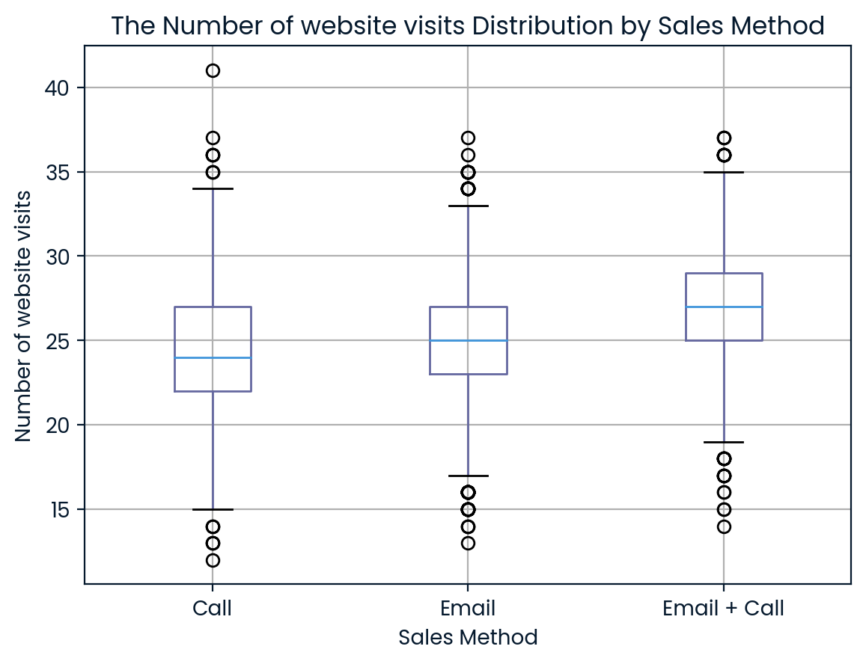
Outcomes
Other differences between the customers in each group
The median of new products sold for Email + Call is 12, compared to the median of 10 for both Email and Call.
The median of website visits for Email + Call is 27, which is greater than 25 for Email and 24 for Call.
Using the Email + Call may lead to an increase in website visits, which appears to positively influence the higher number of new products sold.
Notes:
These two figures were not specifically requested by the sales team, but I added them because they are meaningful.
The distribution of new products sold and website visits for Email+Call show difference compared to Call and Email.
In other words, Email+Call may lead to an increase in website visits, which appears to positively influence the higher number of new products sold.

Slide 8
Business Metric
Definition of a metric for the business to monitor
sales_efficiency = (subtotal_revenue) / (customer_count x time_required)
sales_method | sales_efficiency | subtotal_revenue | customer_count | time_required
Call | 1.59 | 236445.16 | 4962 | 30
Email | 16.17 | 724313.35 | 7466 | 6
Email + Call | 12.25 | 472730.95 | 2572 | 15
This metric is defined by considering the subtotal revenue, the number of customers and the average time (in minutes) required to handle one customer for each sales method.
As the intuitive name suggests, sales_efficiency refers to the revenue generated per minute by each method. When the sales team spends one minute on Email, they generate 16.17 in revenue. For Email + Call, one minute results in 12.25 in revenue. In contrast, spending one minute on Call yield just 1.59 in revenue.
As a result, Email is the most efficient sales method.
Notes:
Now I would like to introduce a metric called sales_efficiency for the business to moniter.
sales_efficiency is equal to subtotal_revenue divided by the product of customer_count and time_required.
As the intuitive name suggests, sales_efficiency refers to the revenue generated per minute by each sales method.
When the sales team spends one minute on Email, they generate 16.17 in revenue. As a result, Email is the most efficient method.

Slide 9
Recommendation
Email + Call is recommended as the best sales method
Email is the most efficient method in terms of time efficiency, but it doesn’t mean that Email generates the highest revenue.
Email just generates quick revenue during the early stage of a new product launch, but its revenue decreases over time and doesn’t maximize revenue per customer.
Email + Call may take more time to generates revenue than Email, but this method allows for maximizing revenue per customer, which leads to the maximum total revenue with reasonable time efficiency.
Notes:
Surprisingly, I would recommend Email+Call as the best sales method.
Email is the most efficient method in terms of time efficiency, but it doesn't mean that Email is the most profitable in this business.
The sales team pursues not only time efficiency but also sales effectiveness.
Email just generates quick revenue during the early stage of a new product launch, but its revenue decreases over time and doesn’t maximize revenue per customer.
On the other hand, Email+Call may take more time to generates revenue than Email, but this method allows for maximizing revenue per customer, which leads to the maximum total revenue with reasonable time efficiency.
Therefore, as long as the metric sales_efficiency of Email+Call is maintained without significant decrease, it should be selected as the best method.
And if there is any significant change in the metric, the components should be reviewed.
Thank you for taking the time to listen to my presentation.

